Slide 1
DAA FLIPPED CLASSROOM ACTIVITY
BY : DEVANSHU, PRANAV,ABHILASH AND PRACHITI

Slide 2
TABLE OF CONTENTS
INTRODUCTION TO BACKTRACKING
WHAT IS HAMILTONIAN CYCLE?
EXAMPLE OF HAMILTONIAN CYCLE
ALGORITHM OF HAMILTONIAN CYCLE
ADVANTAGES AND DISADVANTAGES OF HAMILTONIAN CYCLE

Slide 3
INTRODUCTION TO BACKTRACKING
Backtracking is a technique based on algorithm to solve problem. It uses recursive calling to find the solution by building a solution step by step increasing values with time.
In backtracking problem, the algorithm tries to find a sequence path to the solution which has some small checkpoints from where the problem can backtrack if no feasible solution is found for the problem.
When we have multiple choices, then we make the decisions from the available choices. In the following cases, we need to use the backtracking algorithm:
A piece of sufficient information is not available to make the best choice, so we use the backtracking strategy to try out all the possible solutions.
Each decision leads to a new set of choices. Then again, we backtrack to make new decisions. In this case, we need to use the backtracking strategy.

Slide 4
HAMILTONIAN CYCLE
Hamiltonian cycle (HC): is a cycle which passes
once and exactly once through every vertex of G
and returns to starting position
Hamiltonian path: is a path which passes once and
exactly once through every vertex of G (G can be
digraph).
A graph is Hamiltonian if a Hamiltonian cycle
(HC) exists.

Slide 5
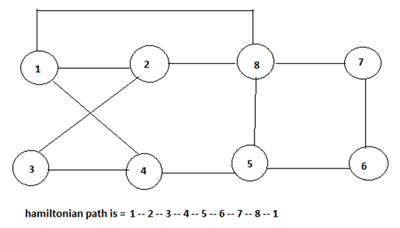
Example of Hamiltonian Cycle

Slide 6
While generating the state space tree following bounding functions are to be considered, which are as follows:
The ith vertex in the path must be adjacent to the (i-1)th vertex in any path.
The starting vertex and the (n-1)th vertex should be adjacent.
The ith vertex cannot be one of the first (i-1)th vertex in the path.

Slide 7
ALGORITHM OF HAMILTONIAN CYCLE
A Hamiltonian cycle is a path in a graph that visits every vertex exactly once and ends up where it started. In other words, it's like taking a walk through a city where you want to visit every intersection exactly once and end up back where you started.
To find a Hamiltonian cycle in a graph, we need to explore all possible paths and check if any of them satisfy the conditions of a Hamiltonian cycle. This is usually done using a recursive algorithm that tries all possible permutations of the vertices in the graph.
Here's a simple explanation of the algorithm:
1. Start at any vertex in the graph.
2. Move to an adjacent vertex that hasn't been visited yet.
3. If all vertices have been visited, check if the current vertex has an edge back to the starting vertex. If it does, we've found a Hamiltonian cycle. If not, backtrack to the previous vertex and try a different path.
4. Repeat steps 2-3 until all possible paths have been explored.

Slide 8
The main challenge in the algorithm is to keep track of which vertices have already been visited and to avoid repeating paths that have already been explored. This can be done using various data structures such as arrays, sets, or hash tables.
Overall, the algorithm is a bit complex and can be time-consuming for large graphs. However, it's a useful tool for solving problems related to finding optimal paths in various domains such as logistics, transportation, and circuit design.

Slide 9
Advantages | Disadvantages
Efficiency Guarantee of solution Useful in circuit design | Computational Complexity No Known Efficient Algorithm Not always possible

Slide 10


